Slide 1

Factors Affecting the Severity of Traffic Accidents
Traffic accidents are a serious global issue, causing numerous deaths and injuries each year. Various factors, including road conditions, weather, lighting, and vehicle types, significantly influence the severity of these accidents. Understanding the key factors contributing to severe accidents can help prevent, traffic authorities, and urban planners implement effective measures to reduce road casualties.
ADY201m
Tool Using
Instructor: NamH3
Python, Power Pi
Member
Date
Ta Quang Tuan
17 - 12 - 2024
Pham Hoang Nam
Nguyen Cao Thanh Trung

Slide 2
Problems Definition
The primary objective of this study is to analyze the key factors influencing the severity of road accidents. By examining various attributes such as weather conditions, lighting, road type, and vehicle type, the study aims to identify patterns and correlations that contribute to accident severity. The findings will help develop recommendations for improving traffic safety and reducing the number of severe accidents.
Approach
Scope
Data Collection: severity,, weather, road, location…
Preprocessing: Python, MySQL
SQL Analysis : Extract insight using SQL Query
EDA: Python
Visualization: Power Pi
Regression Analysis: Python, Scikit_learn
Dataset: Traffic Accident(2019- 2014)
Variables:
+ Dependent: Accident Severity (Slight, Serious, Fatal).
+ Independent: Weather, road, lighting conditions, road type, vehicle type.

Slide 3
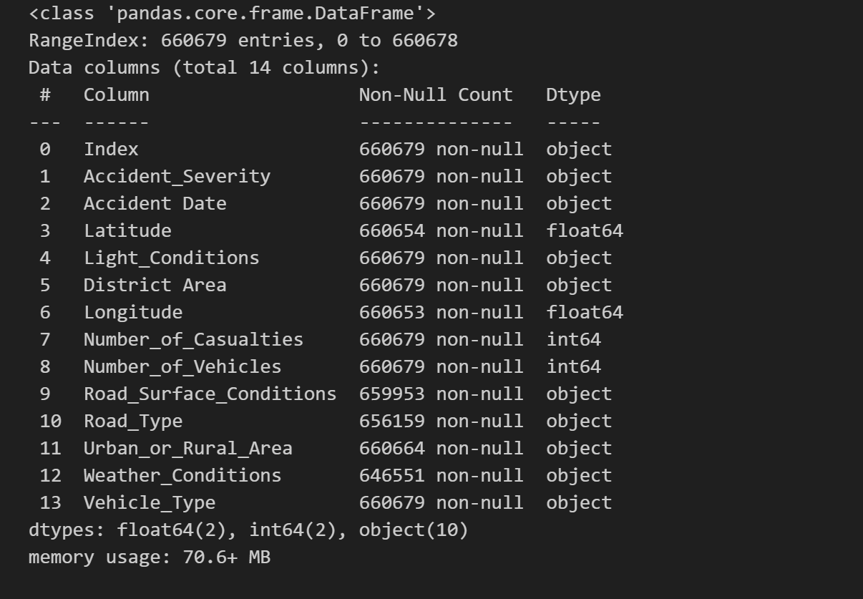
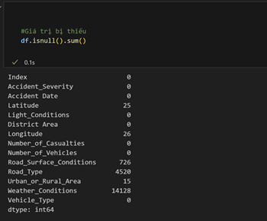
Data Understanding
Source
Data Types
Missing vaule
The dataset was collected from Kaggle, specifically from the project Accident Casualties Prediction by Kerem Ozakca.(from 2019 – 20220)
The dataset consists of 660,679 rows and 14 attributes

Slide 4
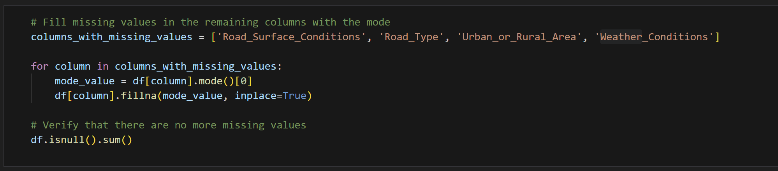
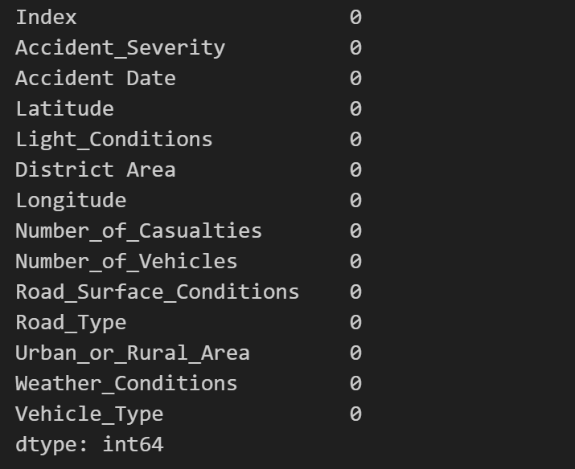
Data Understanding
Handling missing categorical data
Input
Output

Slide 5
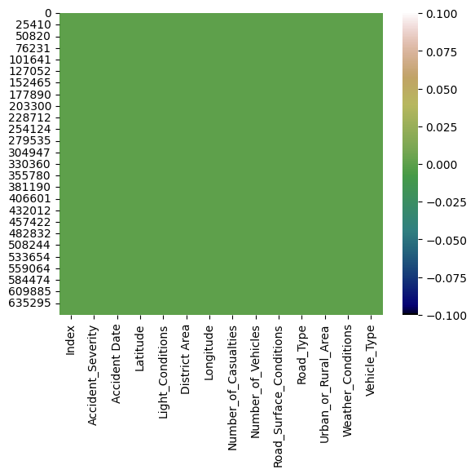
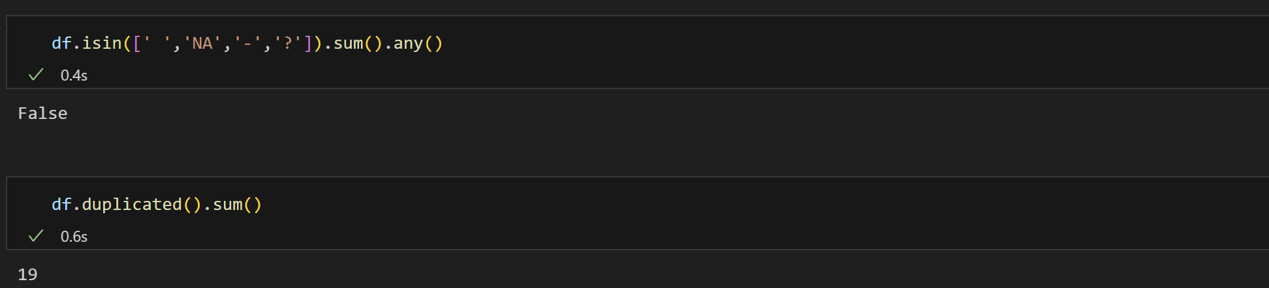
Data Understanding
Handling Duplicates:
Duplicated records are dropped to prevent skewed analysis.
A heatmap after cleaning confirms that the data is now clean and ready for analysis.

Slide 6
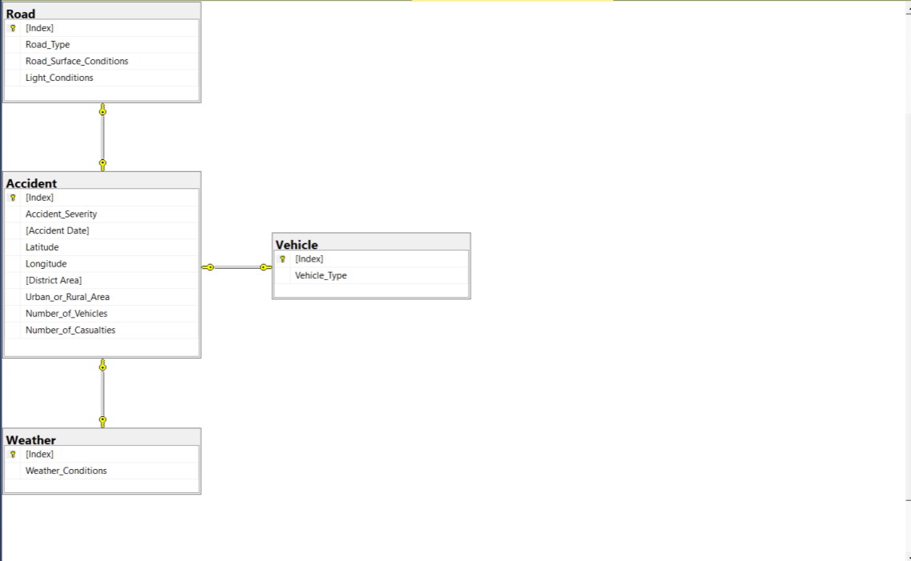

Analysis with SQL
CREATE TABLE Weather (
WeatherID INT PRIMARY KEY IDENTITY(1,1),
Weather_Conditions VARCHAR(100) NOT NULL
);
CREATE TABLE Vehicle (
VehicleID INT PRIMARY KEY IDENTITY(1,1),
Vehicle_Type VARCHAR(100) NOT NULL
);
CREATE TABLE Road (
RoadID INT PRIMARY KEY IDENTITY(1,1),
Road_Type VARCHAR(100) NOT NULL,
Road_Surface_Conditions VARCHAR(100),
Light_Conditions VARCHAR(100)
);
CREATE TABLE Accident (
AccidentID INT PRIMARY KEY IDENTITY(1,1),
Accident_Severity INT CHECK (Accident_Severity BETWEEN 1 AND 5),
Accident_Date DATE NOT NULL,
Latitude DECIMAL(10,7),
Longitude DECIMAL(10,7),
District_Area VARCHAR(100),
Urban_or_Rural_Area VARCHAR(50),
Number_of_Vehicles INT,
Number_of_Casualties INT,
WeatherID INT FOREIGN KEY REFERENCES Weather(WeatherID),
VehicleID INT FOREIGN KEY REFERENCES Vehicle(VehicleID),
RoadID INT FOREIGN KEY REFERENCES Road(RoadID)
);

Slide 7
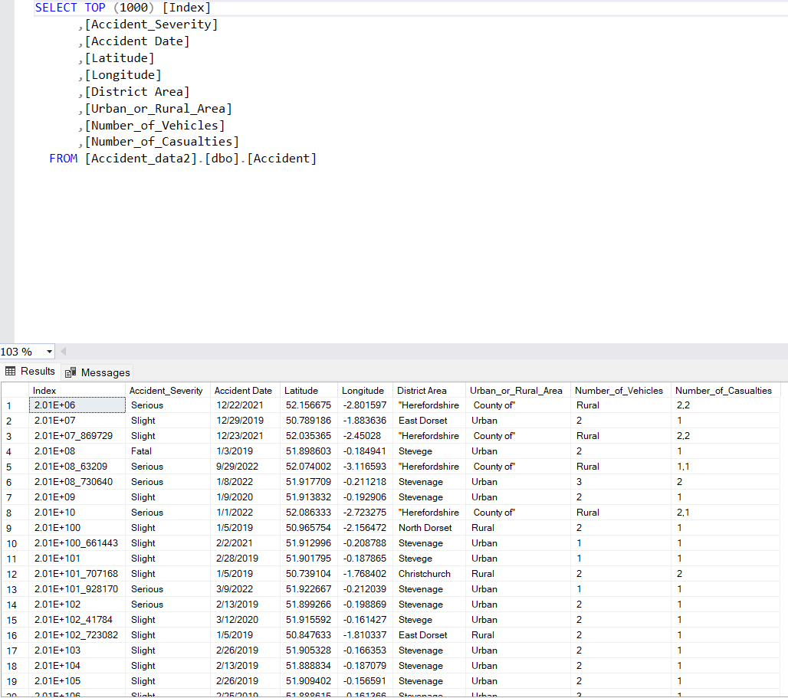
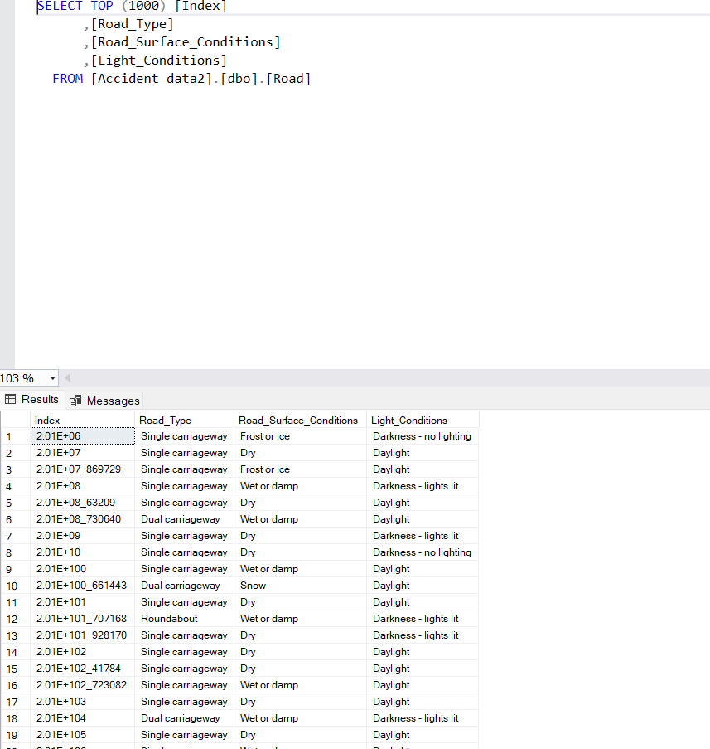
Analysis with SQL

Slide 8

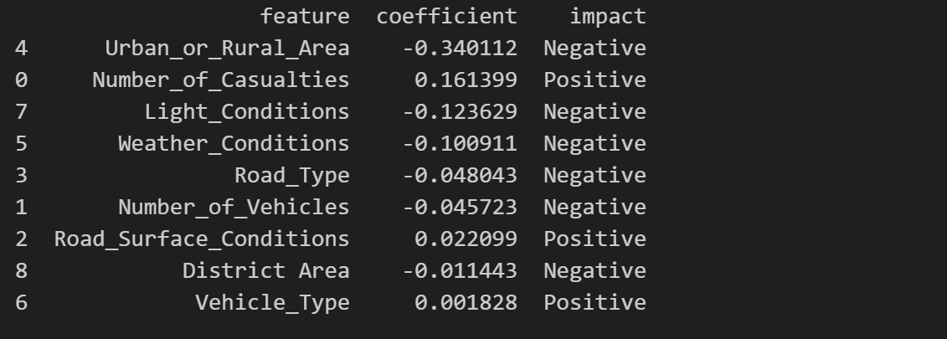
REGRESSION ANALYSIS
-Introduction to the Methodology
- To determine the impact of features on the target variable, we use a Logistic Regression model with data standardized using StandardScaler . The coefficients of each feature indicate their level of influence on the dependent variable.
-Interpreting the Coefficients
- Explain the meaning of feature coefficients
+A positive coefficient means the feature has a positive impact on the target variable.
+A negative coefficient indicates a negative impact on the target variable.
+The larger the absolute value of a coefficient, the stronger its influence.
Code
result

Slide 9
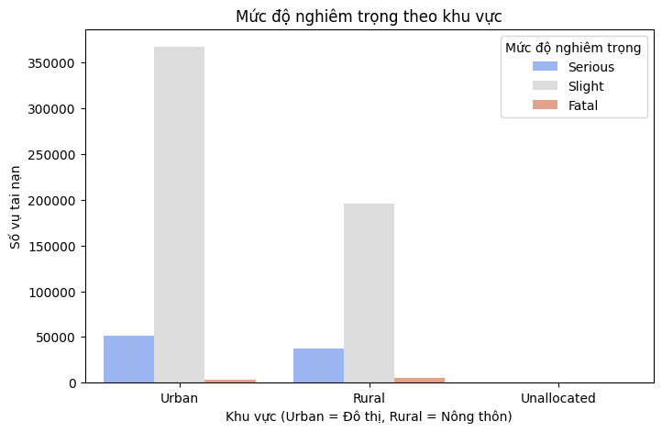
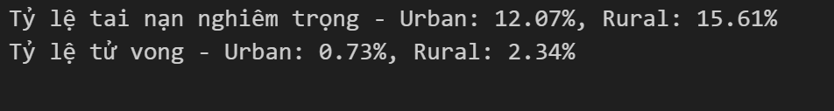
Analysis with Python
Urban_or_Rural_Area
Severity by area:
Serious accident rate between the two area
Conclusion Serious accidents are more frequent in rural areas (15.61%) than urban areas (12.07%), despite the higher total number of urban accidents. Key reasons include higher speeds, limited medical facilities, and poorer road quality.
Rural areas also have a significantly higher mortality rate (2.34% vs. 0.73%), with accidents being 3.2 times more likely to be fatal. Contributing factors include high-speed collisions, poor lighting, and delayed emergency response

Slide 10
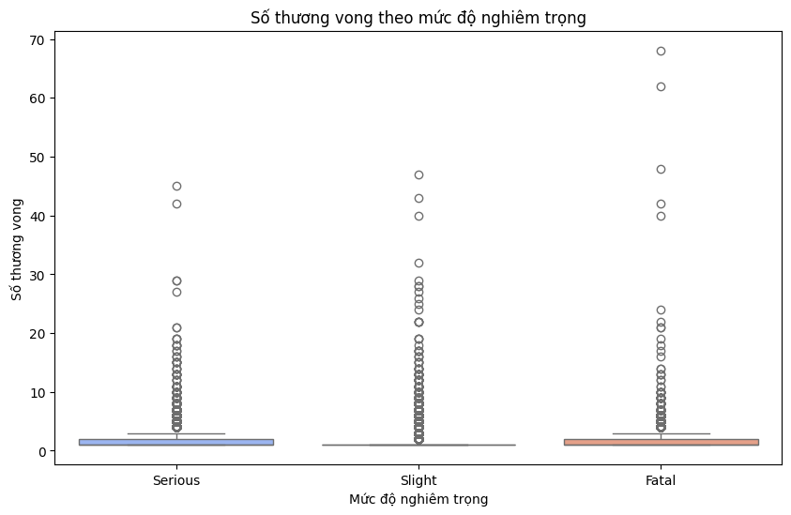
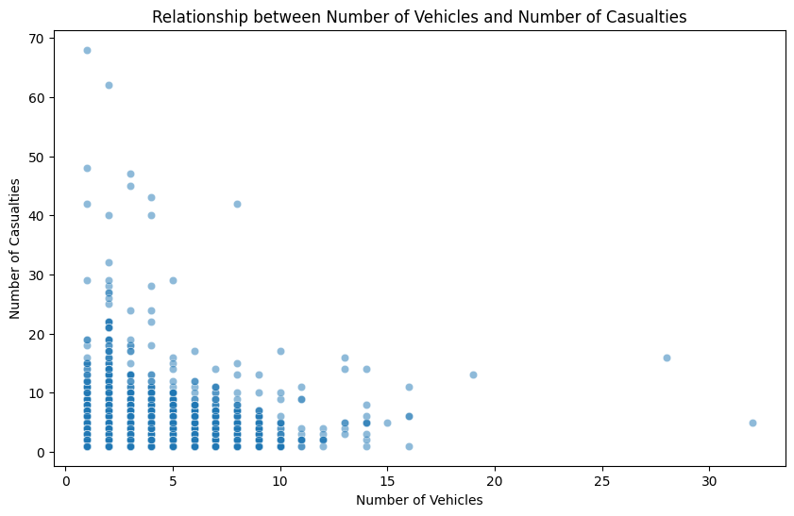
B.Number_of_Casualties
Compare casualties by severity
Relationship between Number_of_Vehicles and Number_of_Casualties
Most accidents have low casualty numbers, with a fairly small median value.
There were more accidents with higher casualties, but the main distribution remained low. There were several accidents resulting in more than 50 casualties, suggesting it could be a bus accident or a major traffic accident.
Correlation between Number of Vehicles and Number of Casualties: 0.23
Very weak correlation (Correlation = 0.23)
The correlation value of 0.23 shows that the relationship between the number of vehicles and the number of casualties is very weak, with almost no clear trend.
This means that accidents with more vehicles do not necessarily have more casualties.

Slide 11
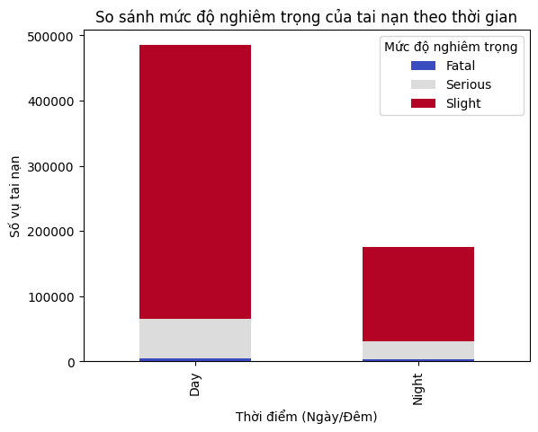
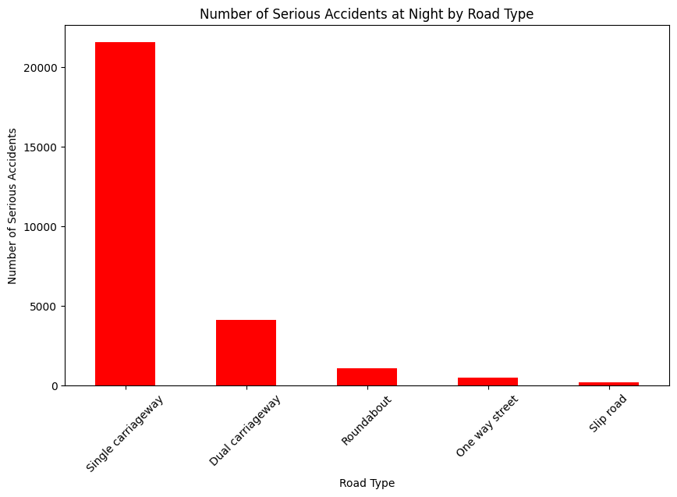
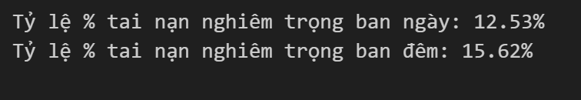
C.Light Condition
Compare accident severity over time
Number of Serious Accidents at Night by Road Type
There may be fewer vehicles at night, but accidents that do occur tend to be more serious.
More accidents in the day, but serious accidents are more common at night (15.62% vs. 12.53%).
Nighttime risks: Poor lighting, fatigue, and higher speeds increase severity.
Daytime traffic: More accidents but at lower speeds, reducing severity.
Nighttime conditions: Fewer vehicles, higher speeds, more severe accidents.
Single Carriageways have the most serious accidents, likely due to high speeds and poor visibility.
Dual Carriageways rank second but have far fewer accidents than Single Carriageways.
Roundabouts, One-way streets, and Slip roads see fewer serious accidents, possibly due to lower traffic or better safety.
Safety improvements like better lighting and speed limits are needed for Single Carriageways at night.

Slide 12
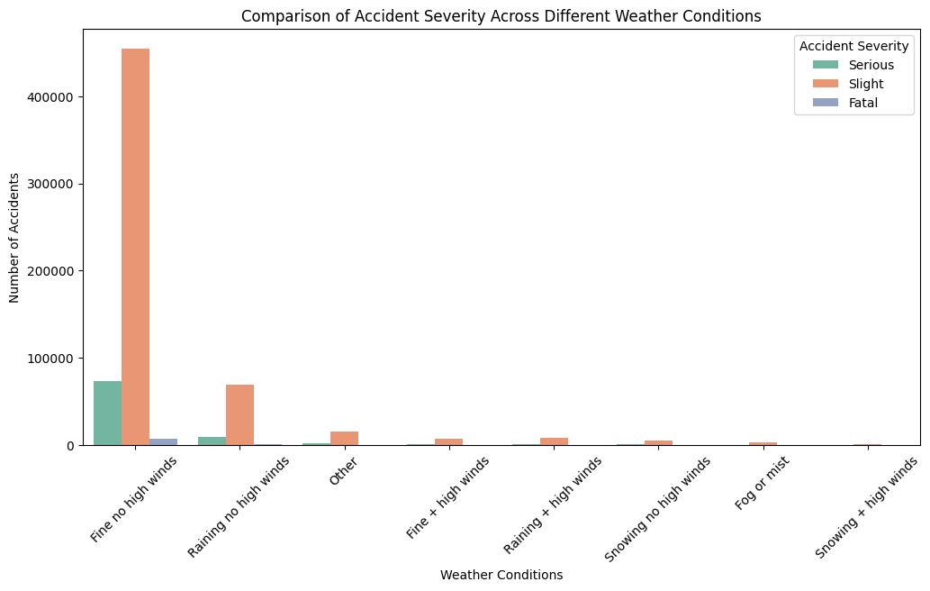
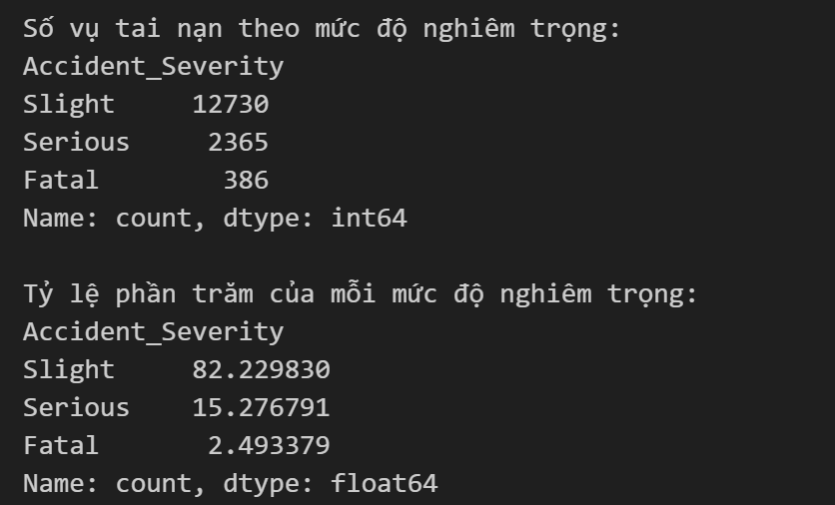
D.Weather Condition
Accident severity across different weather conditions
Severity in bad weather conditions, rural areas at night

Slide 13
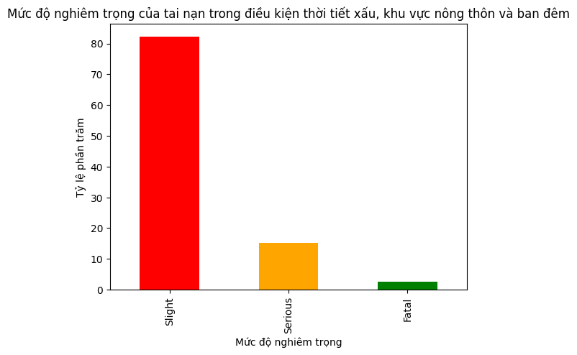
D.Weather Condition
Slight accidents dominate (over 80%), despite risks from bad weather, rural areas, and nighttime.
Likely due to adherence to safety measures and moderate speeds.
Serious accidents make up ~15%, indicating many severe injuries.
Contributing factors:
Poor visibility (weather, lack of lighting).
Speeding or loss of control on slippery roads.
Delayed emergency response in rural areas.
Fatal accidents are low (2.49%) but still concerning.
386 fatalities remain a significant issue.

Slide 14
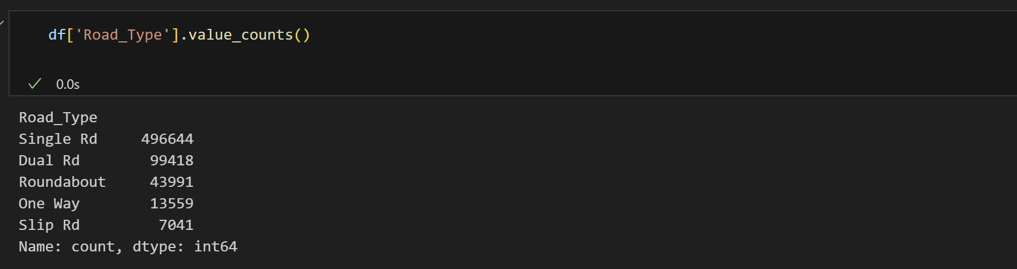
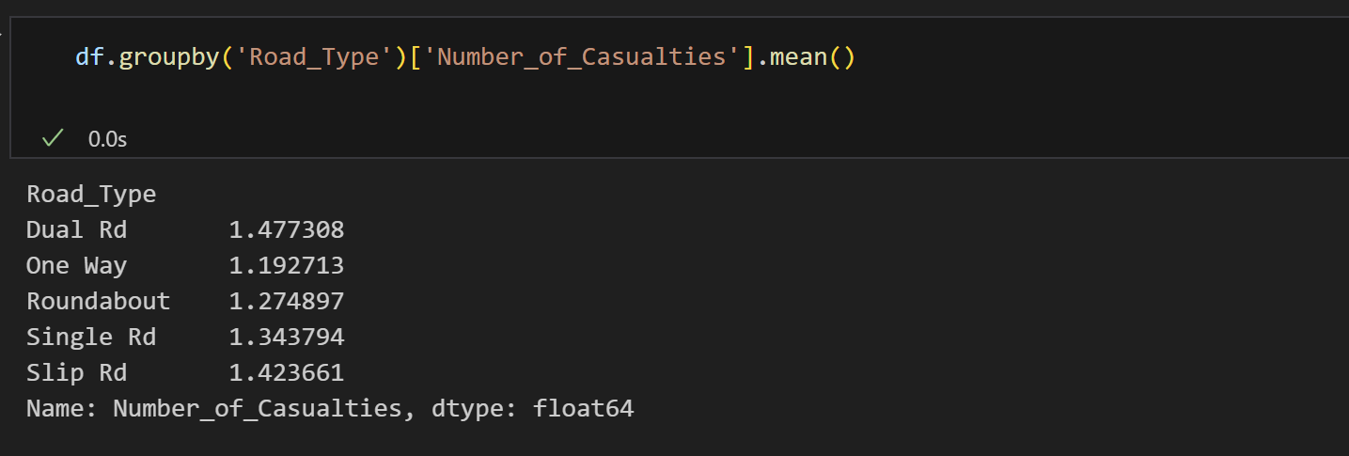
E.Road Type
Check the distribution of Road Type
How does Road Type affect casualties?
Most accidents happen on single carriageways (two-way roads without medians).
Dual carriageways (roads with medians) have fewer accidents, possibly due to higher speed limits, but are also safer.

Slide 15
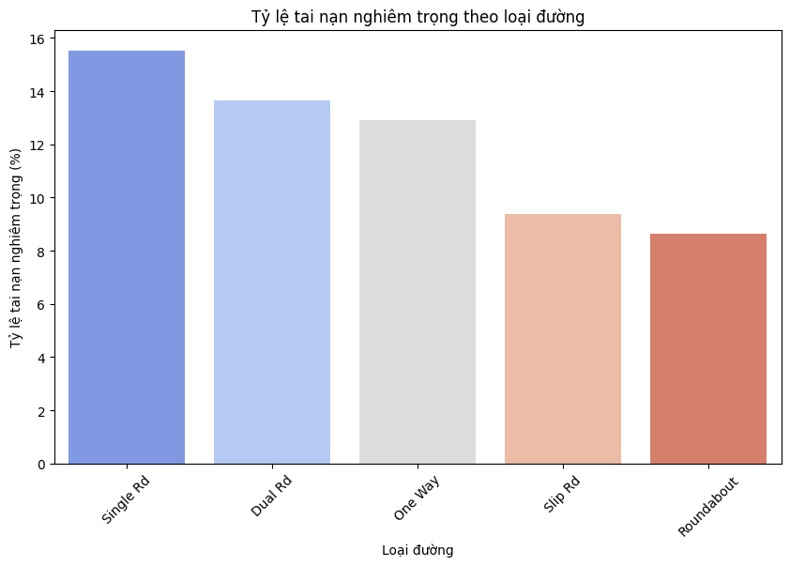
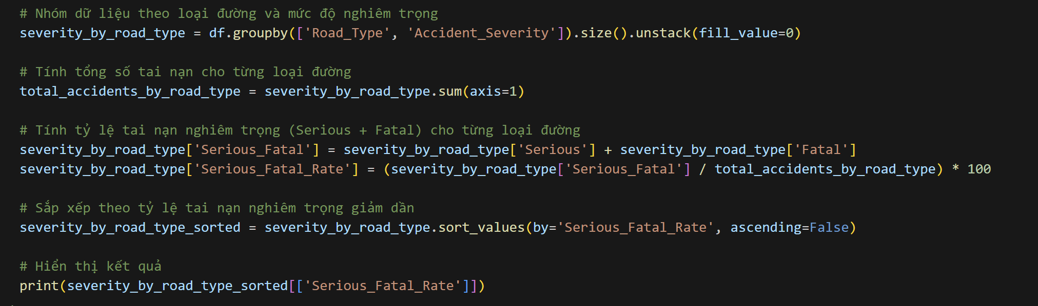
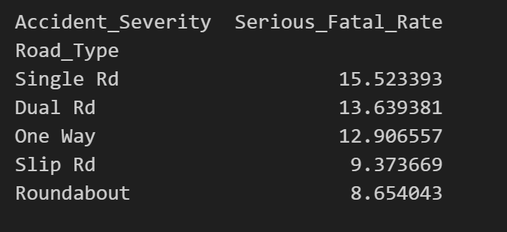
E.Road Type
Serious + Fatal accident rates for each road type
CODE
RESULT
Single carriageways are the most dangerous but have fewer fatalities.
Dual carriageways are riskier, with a higher fatality rate.
Roundabouts & one-way streets are relatively safer.
Motorway & slip road accidents are rare but severe due to high speeds.
Safety measures: Speed control on dual carriageways, warnings on single carriageways, and better roundabout design

Slide 16
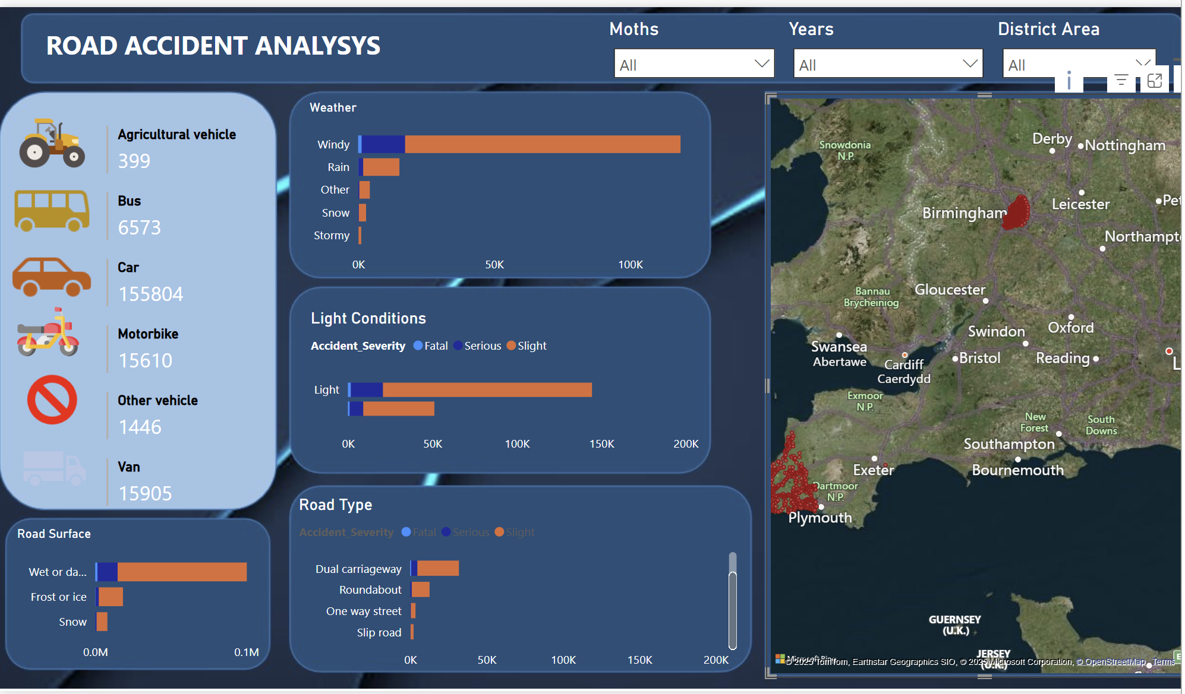
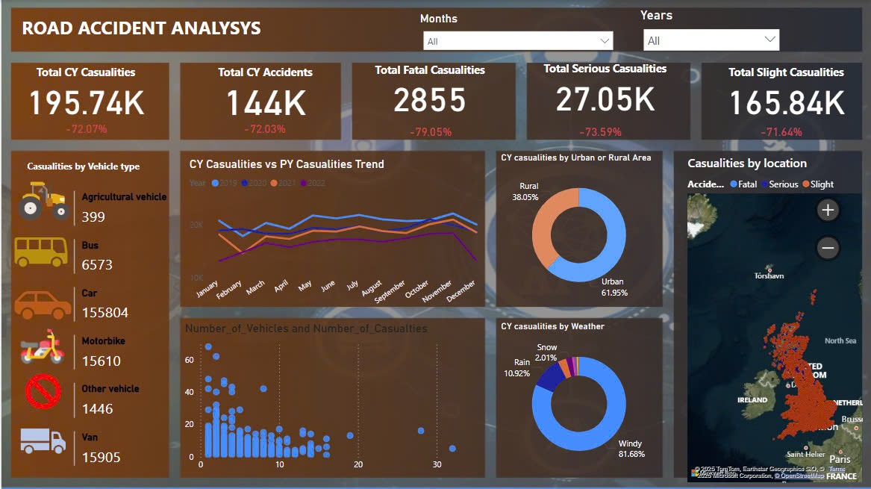
VISUALIZATION
Conclusion This study analyzed factors affecting road accident severity in the UK (2019-2022):
Lighting Conditions: Accidents at night without street lighting tend to be more severe.
Road Type: Single-lane roads and rural areas have more serious accidents due to high-speed driving.
Weather Conditions: Rain increases accidents, while fog and snow have less impact due to reduced traffic.
Vehicle Type: Motorcycles and bicycles have higher casualty rates than cars and heavy vehicles.

